Slide 1



Startup Idea
Automated Pest Detection & Control
Empowering Farmers with Real-Time Pest Monitoring & Control using Embedded Systems.
Anik Dasgupta (Founder and Lead Developer)
B.Tech-M.Tech student at NFSU, Guwahati.

Slide 2
General Background of Start-up
I am trying to develop an Embedded Systems based Smart Pest Detection and Control System that uses sensors to detect insect frequencies in real-time, triggering automated pest control applications only when pests are present. This technology will allow farmers to target infestations precisely, reducing crop damage, minimizing pesticide and insecticide use, and lowering costs.
This system integrates seamlessly with existing agricultural practices, offering a sustainable, cost-effective solution for farms of all sizes. With the growing demand for precision agriculture, this product addresses a key challenge in pest management, empowering farmers to increase yields and protect the environment.
I am focused on delivering a scalable, eco-friendly tool that modernizes farming practices and drives the future of sustainable agriculture.

Slide 3
Problems surrounding Agriculture & Overuse of Pesticides
However the overuse of pesticides leads to several problems, including but not limited to:
Environmental Damage: Excessive pesticides contaminate soil and water, harming ecosystems and beneficial organisms like pollinators.
Human Health Risks: Prolonged exposure to chemical pesticides can pose serious health risks to farmers and consumers.
Pesticide Resistance: Over time, pests can develop resistance to commonly used pesticides, making them less effective and forcing farmers to apply higher doses, further exacerbating the problem.
Agriculture faces numerous challenges, with one of the most pressing being pest infestations, which cause significant crop loss globally. To combat this, many farmers rely heavily on pesticides and insecticides. They are chemicals used to control, repel, or kill plants and animals, but they can pose significant risks to human health and the environment.

Slide 4
Delving into the Statistics
Between 20% to 40% of global crop production is lost to pests annually.
Each year, plant pests and diseases cost the global economy around $220 billion, and invasive insects around $70 billion, according to the Food and Agriculture Organization of the United Nations.
Extreme use of pesticides can result in severe water & soil contamination and can also intoxicate plants with harmful chemicals.
Additionally, insects and bugs become reluctant against them with continuous exposure that forces farmers to rely on heavier pesticides.
Even though other methods like genetic seed manipulation are also being used to make crops more robust against the pest attack, they are quite expensive for practical application.

Slide 5
Project Details

Slide 6
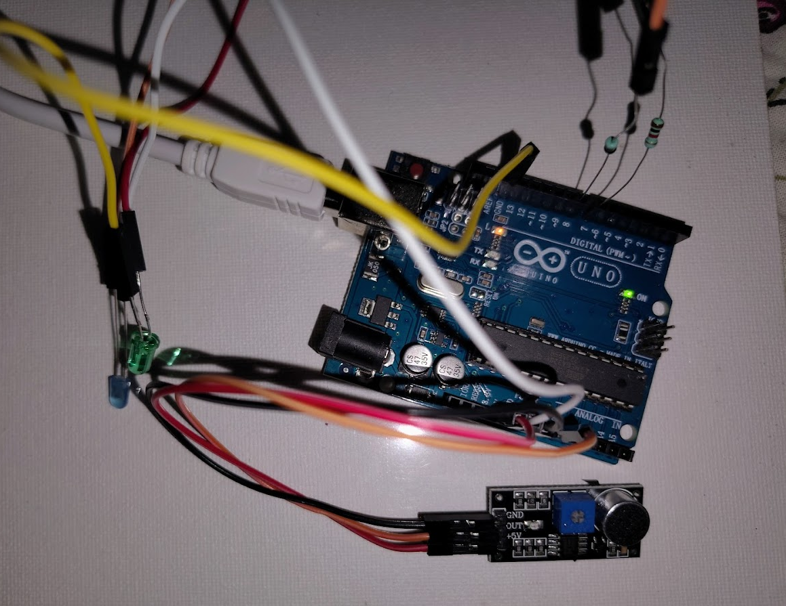
Overview
The project involves the development of a smart pest detection system using Embedded Systems Technology to detect insect activity in agricultural fields and automatically deploy targeted pesticide sprays. The system is designed to minimize crop damage while reducing pesticide use, making it a sustainable solution for modern farming.
Earliest prototype of the Product

Slide 7
Core Components
High-Sensitivity Frequency Sensors: Detect specific sound frequencies emitted by pests, allowing for precise identification of harmful insects in the field.
Arduino UNO Board: Acts as the central processor, interpreting sensor data and triggering the pesticide spray mechanism.
Automated Pest Control: Once pests are detected, the system will activate an automated pest control device only when necessary.
Wireless Communication: The system will send alerts to farmers through mobile or web interfaces, providing real-time updates on pest activity and pesticide usage.

Slide 8
Key Features
Real-Time Detection: Continuous monitoring of pest activity in the field, enabling quick responses.
Automated Action: The system autonomously applies pest control systems, reducing labor and manual intervention.
Eco-Friendly: By activating pest control only when pests are detected, it minimizes the overuse of chemicals, protecting both crops and the environment.
Scalability: Designed for farms of all sizes, the system can be deployed in small or large-scale operations with multiple units across fields.

Slide 9
Research and Development Focus
The project's emphasis is on R&D, with the goal of refining sensor technology for better pest detection accuracy, enhancing the system's efficiency, and making it adaptable to various farming environments. The R&D process is focused on making the system affordable and easy to integrate into existing farming practices.

Slide 10
Impact
For Farmers: The system helps farmers reduce crop loss, cut down on pesticide expenses, and improve overall yield. It's particularly beneficial for smallholder farmers who need cost-effective solutions.
For the Environment: By reducing unnecessary pesticide usage, the system promotes sustainable farming and reduces the negative impact of chemicals on the ecosystem.
For Society: The solution contributes to food security by helping farmers increase productivity while adhering to environmentally-friendly practices.
This project is driven by a passion for innovation, with the goal of creating a practical, scalable, and eco-friendly solution that benefits both farmers and the environment.

Slide 11
Value Proposition

Slide 12
Business Idea
Although, my primary goal is not centered around business and profit, but rather on research and development to create an innovative solution that will directly benefit farmers and the agricultural community. I am committed to developing a smart, embedded systems-based pest detection system that can revolutionize how pest control is managed in agriculture. By focusing on precision pest detection, I aim to provide a tool that reduces the overuse of pesticides, enhances crop protection, and promotes environmentally sustainable farming.
I believe in creating solutions that solve real-world problems, and my emphasis is on continuous R&D to ensure that the technology is accessible, adaptable, and beneficial for farmers of all scales, particularly smallholder and organic farmers who often struggle with effective pest control.
By prioritizing the greater good and focusing on delivering a meaningful impact over profits, I aim to bring long-term benefits to the farming community and society as a whole.

Slide 13
The Embedded-Systems-Based Smart Pest Detection and Control System offers farmers a cost-effective, eco-friendly, and precise solution for managing pest infestations. Unlike traditional pesticide application methods, which are often wasteful and harmful to the environment, this system uses real-time pest detection technology to target insects only when necessary, reducing chemical use and minimizing crop damage.
By combining advanced sensors with automated pest control application, the system empowers farmers to:
Increase crop yields by preventing pest damage before it spreads.
Reduce pesticide costs through targeted application, lowering the overall usage.
Promote sustainability by minimizing the environmental impact of excessive pesticide use.
Save time and labor with a fully automated solution that requires minimal manual intervention.
My focus on research and development will ensure continuous improvement, making the system more adaptable, scalable, and accessible to all farmers, from smallholder farms to large agricultural operations. Ultimately, the system contributes to sustainable agriculture, food security, and a healthier environment.

Slide 14
Marketing Strategy

Slide 15
Target Market
Small and Medium-Sized Farmers: Emphasize cost-effective, eco-friendly pest control for smallholder and organic farmers looking to reduce pesticide use and improve yields.
Large-Scale Commercial Farms: Highlight the scalability of the system and its ability to cover large fields efficiently.
Agri-Tech Companies: Partner with Agri-tech firms to integrate the system into broader precision farming solutions.
Government and Agricultural Agencies: Collaborate with government initiatives focused on sustainable farming practices and environmental protection.

Slide 16
Channels and Tactics
Digital Marketing:
Leverage social media platforms (Facebook, Instagram) and Agri-tech forums to share success stories, testimonials, and educational content.
Use targeted digital ads to reach farmers and Agri-tech companies.
Field Demonstrations: Host workshops and live demonstrations in agricultural communities, allowing farmers to see the system in action.
Partnerships:
Collaborate with agricultural cooperatives and retailers for distribution.
Partner with Agri-tech companies to bundle the system with other smart farming tools.

Slide 17
Pricing Strategy
Flexible Pricing Options:
Offer tiered pricing based on farm size and system capacity.
Provide a subscription model for software updates and remote monitoring services.
Pilot Program Discounts: Offer discounted pricing to early adopters and pilot program participants to build initial customer traction.

Slide 18
Execution Plan
Phase 1: Research & Development (Months 1-9)
Objective: Develop a functional prototype and conduct initial testing.
Key Activities:
Design the core hardware system: integrate high-sensitivity frequency sensors, Arduino board, and automated pesticide spray mechanism.
Develop the software for real-time data processing and sensor control.
Conduct in-lab testing of sensors and automation to ensure system reliability.
Deliverables:
Working prototype ready for field testing.
Initial software version for basic monitoring and automated response.
Phase 2: Pilot Testing & Iteration (Months 9-15)
Objective: Test the system in real-world agricultural settings to gather data and refine the product.
Key Activities:
Deploy the system in pilot farms across various regions to test in diverse environmental conditions.
Gather data on pest detection accuracy, pesticide usage, and crop health.
Collect feedback from farmers and early adopters to identify areas of improvement.
Refine the hardware and software based on pilot feedback.
Deliverables:
Data from field tests validating the system’s effectiveness.
Finalized version of the product based on field trials.

Slide 19
Execution Plan
Phase 3: Product Launch & Market Entry (Months 15-19)
Objective: Officially launch the product and begin marketing and distribution efforts.
Key Activities:
Finalize production partnerships for large-scale manufacturing of the system components.
Develop and implement a marketing strategy, including digital marketing, field demonstrations, and partnerships with Agri-tech retailers.
Set up distribution channels (direct sales, online platforms, agricultural retailers).
Engage in trade shows and product demonstrations to raise awareness.
Deliverables:
Product available for sale in target markets.
Initial customer base, including early adopters and partnerships with agricultural cooperatives.
Phase 4: Scale & Expansion (Months 19-36)
Objective: Scale operations, grow market share, and expand into new regions.
Key Activities:
Increase production capacity to meet growing demand.
Expand the system’s functionality by integrating advanced features like predictive analytics using machine learning.
Explore international markets, particularly in regions with high pest pressure.
Secure additional funding for R&D and operational expansion, if needed.
Deliverables:
Expanded product line with new features.
Significant growth in customer base and presence in multiple regions

Slide 20
Execution Plan
Phase 5: Continuous Improvement & Support (Month 36 onwards)
Objective: Ensure product longevity and customer satisfaction through continuous support and upgrades.
Key Activities:
Offer regular software updates for system improvements and bug fixes.
Provide ongoing customer support and maintenance services.
Gather post-launch feedback and conduct R&D to introduce future upgrades.
Deliverables:
Continuous product improvement.
High customer retention and satisfaction.

Slide 21
Milestones & Key Deliverables
Prototype Development (Month 9)
Pilot Program Launch (Month 10)
Product Refinement Based on Pilot Feedback (Month 12)
Full Product Launch (Month 19)
Market Expansion and Scaling (Month 36)

Slide 22
Resources Needed
Budget & Financial Plan
R&D Team: Hardware and software engineers, agricultural experts.
Pilot Farmers: For testing and gathering real-world data.
Marketing & Sales Team: To execute go-to-market strategies.
Manufacturing Partners: For large-scale production of the system.
R&D: ₹2,00,000 (first 6 months)
Pilot Testing: ₹1,50,000 (field trials, farmer partnerships)
Marketing & Launch: ₹1,20,000 (digital campaigns, demos, trade shows)
Manufacturing Setup: ₹2,00,000 (initial production runs)
Operations & Expansion & Miscellaneous: ₹1,30,000 (scaling, customer support)

Slide 23

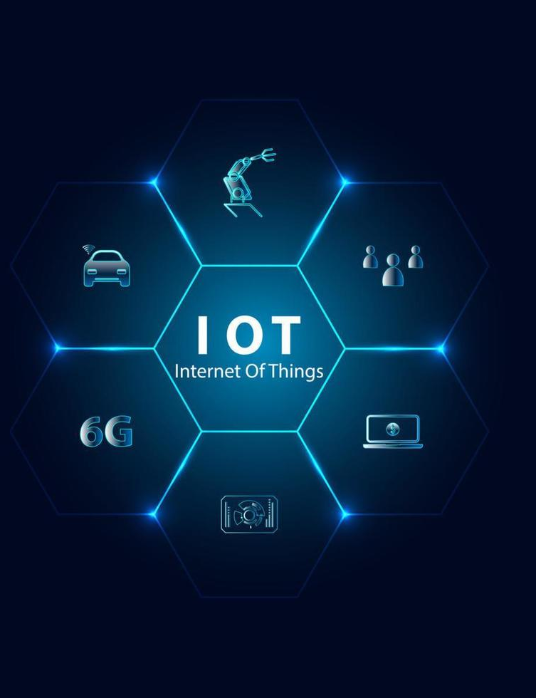



Thank you!
For your time and attention.
Any Questions?

